Slide 1
Results PET MR Age

Slide 2
CU

Slide 3
Correlations
SUMMARYSUVR_WHOLECEREBNORM
FDG-PET BAG
n r CI95% p-val
spearman 230 0.071075 [-0.06, 0.2] 0.28737
MRI BAG:
n r CI95% p-val
spearman 230 -0.026349 [-0.16, 0.1] 0.693594
ABETA42_recalculated
FDG-PET BAG
n r CI95% p-val
spearman 210 -0.155491 [-0.29, -0.02] 0.025633 *
MRI BAG:
n r CI95% p-val
spearman 210 -0.034029 [-0.17, 0.1] 0.627265
TAU
FDG-PET BAG
n r CI95% p-val
spearman 210 -0.0445 [-0.18, 0.09] 0.525348
MRI BAG:
n r CI95% p-val
spearman 210 -0.032743 [-0.17, 0.1] 0.640342
PTAU
FDG-PET BAG
n r CI95% p-val
spearman 209 -0.053813 [-0.19, 0.08] 0.443483
MRI BAG:
n r CI95% p-val
spearman 209 -0.029502 [-0.17, 0.11] 0.674554
PTAU.ABETA42
FDG-PET BAG
n r CI95% p-val
spearman 209 0.120105 [-0.02, 0.25] 0.086283 +
MRI BAG:
n r CI95% p-val
spearman 209 -0.000642 [-0.14, 0.14] 0.992709
ADNI_EF
FDG-PET BAG
n r CI95% p-val
pearson 237 0.012923 [-0.12, 0.14] 0.844115
MRI BAG:
n r CI95% p-val
pearson 237 0.03708 [-0.09, 0.16] 0.572505
ADNI_MEM
FDG-PET BAG
n r CI95% p-val
pearson 237 -0.014314 [-0.14, 0.11] 0.827588
MRI BAG:
n r CI95% p-val
pearson 237 -0.023679 [-0.15, 0.1] 0.718605

Slide 4
Cognitive Outcome
PET.BAG
237 subjects with full information.
AUC: 0.6336397194536729
Feature importance: ['PET.BAG']
MRI.BAG
237 subjects with full information.
AUC: 0.5507087486157253
Feature importance: ['MRI.BAG']
Hippocampus_GMV
237 subjects with full information.
AUC: 0.7374492432631967
Feature importance: ['Hippocampus_GMV']
SUMMARYSUVR_WHOLECEREBNORM
230 subjects with full information.
AUC: 0.5473170731707317
Feature importance: ['SUMMARYSUVR_WHOLECEREBNORM']
Precuneus_SUVR
237 subjects with full information.
AUC: 0.5690365448504984
Feature importance: ['Precuneus_SUVR']
PTAU.ABETA42
209 subjects with full information.
AUC: 0.5999431009957326
Feature importance: ['PTAU.ABETA42']
MMSE
237 subjects with full information.
AUC: 0.45713732004429686
Feature importance: ['MMSE']
meanage
237 subjects with full information.
AUC: 0.6596419342930971
Feature importance: ['meanage']
FDG-PET BAG:
Source SS DF F p-unc np2
DX.cat.n 14.864316 1 1.269554 0.261014 0.005442
PTEDUCAT 32.863926 1 2.806892 0.095207 0.011954
APOE4 1.042982 1 0.089081 0.765616 0.000384
PTGENDER 9.511962 1 0.812412 0.368343 0.003490
Residual 2716.325163 232 NaN NaN NaN
MRI BAG:
Source SS DF F p-unc np2
DX.cat.n 5.965793 1 0.588828 0.443653 0.002532
PTEDUCAT 0.884753 1 0.087326 0.767869 0.000376
APOE4 3.240248 1 0.319815 0.572265 0.001377
PTGENDER 168.085840 1 16.590200 0.000064 0.066737
Residual 2350.539230 232 NaN NaN NaN
Mean PET BAG stables: [0.25622209], mean PET BAG decliners: [0.91459078].
Mean MRI BAG stables: [0.04624971], mean MRI BAG decliners: [0.78794796].

Slide 5
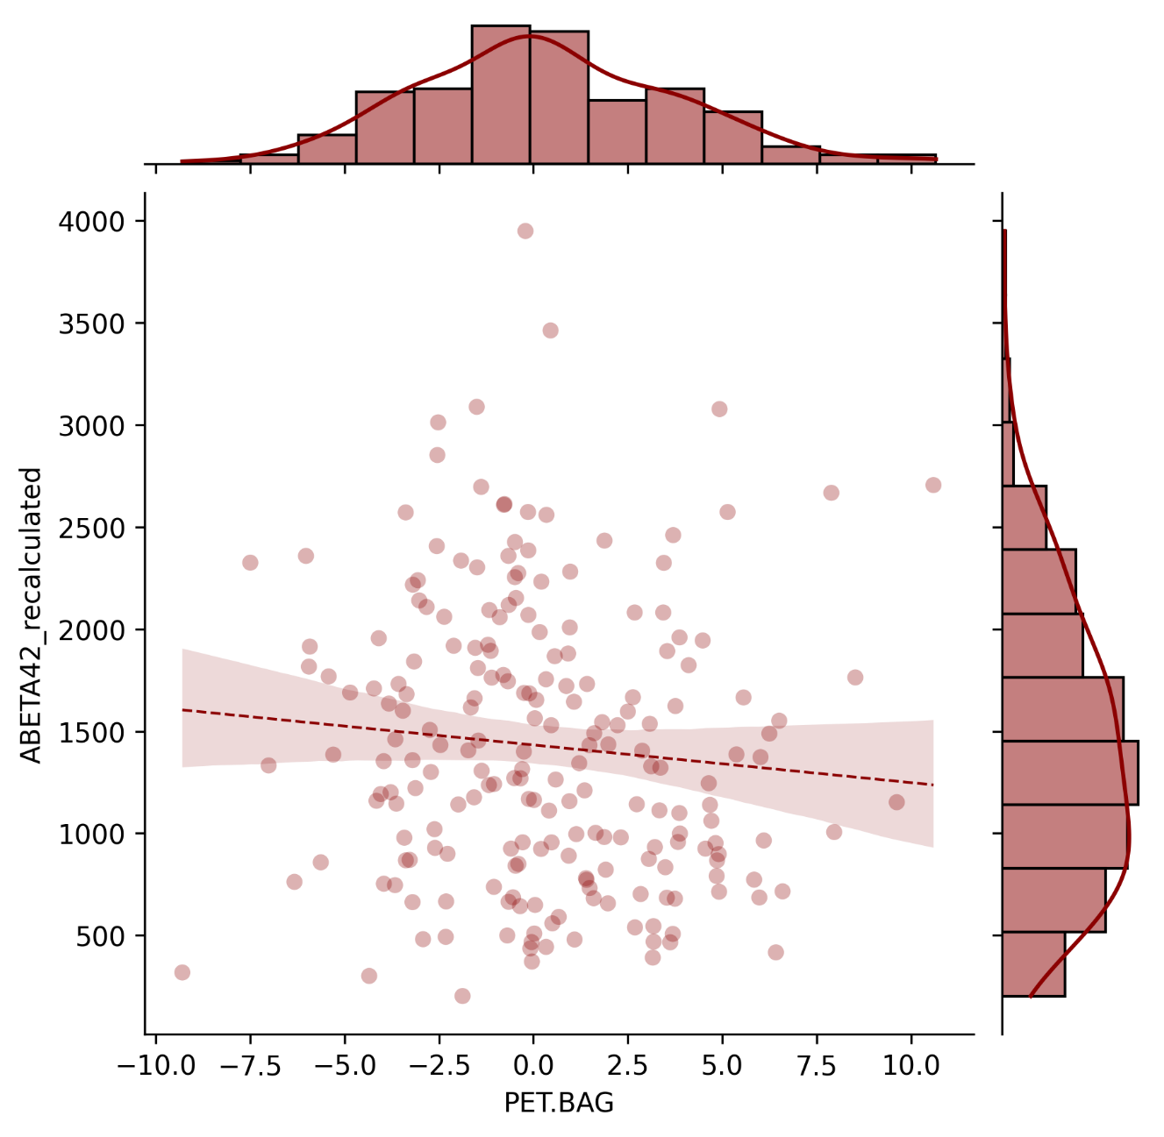
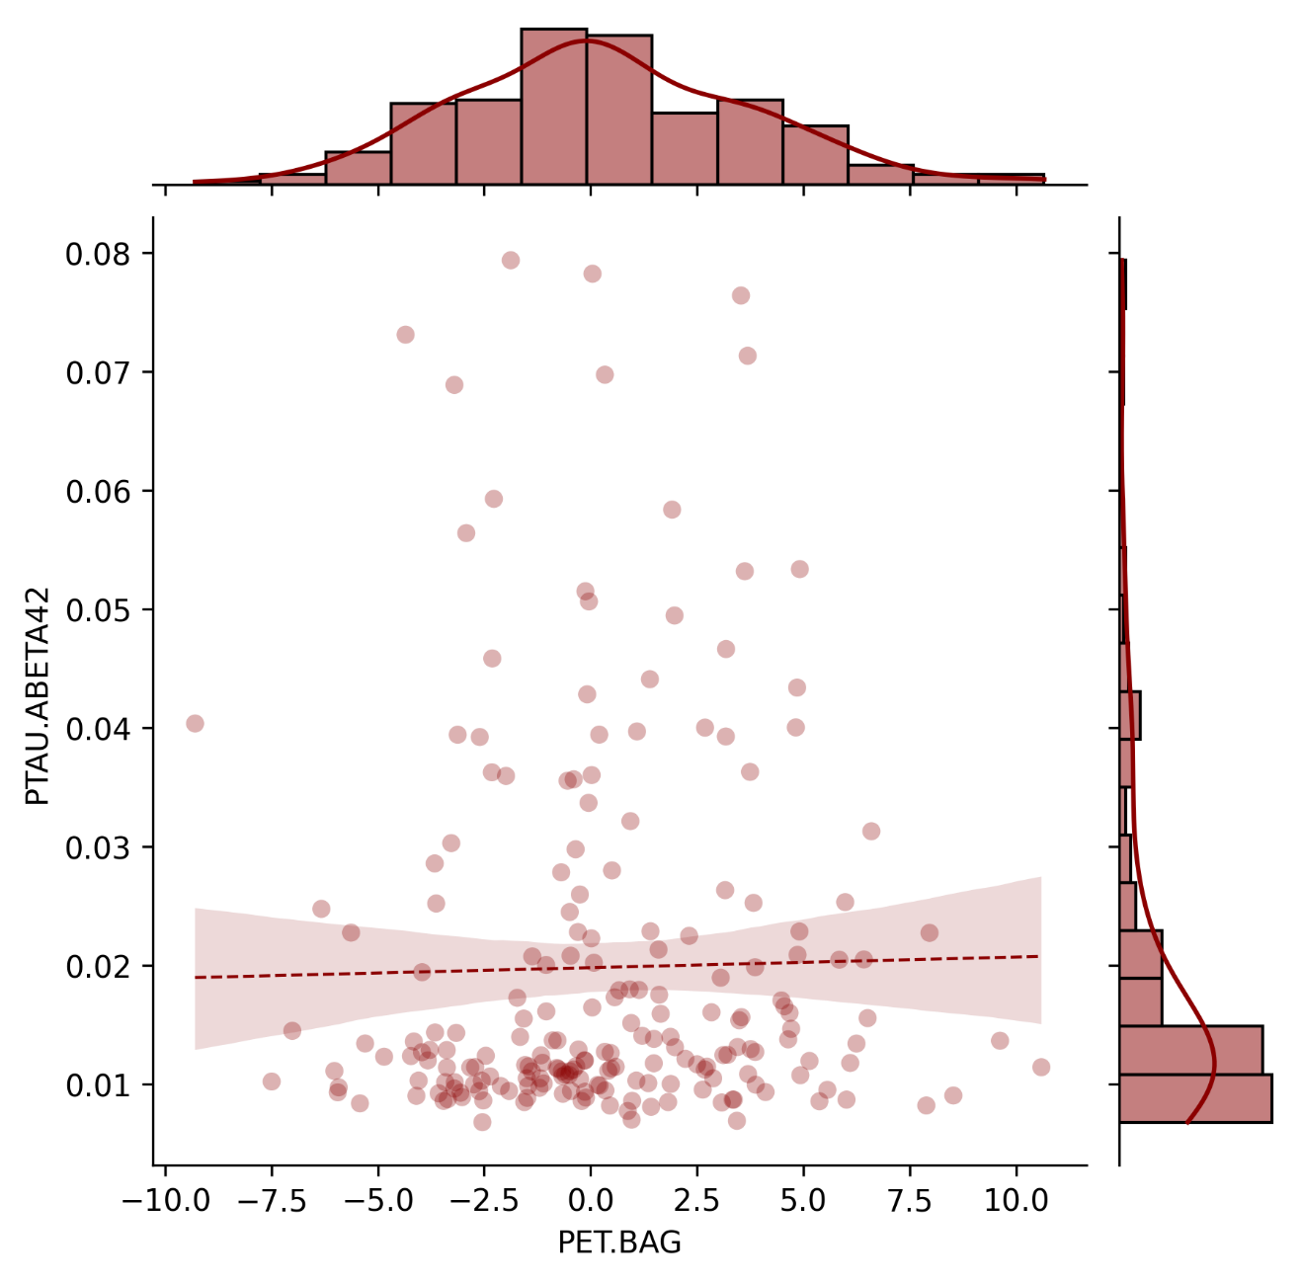
Pathology
CSF Aβ₁₋₄₂ [pg/ml]
p-Tau₁₈₁/CSF Aβ₁₋₄₂ ratio
FDG-PET BAG [years]
FDG-PET BAG [years]

Slide 6
Interaction effect amyloid?

Slide 7
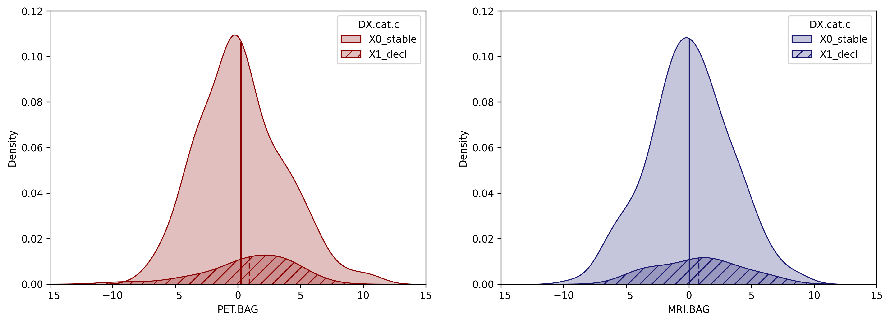
Category
Category
Stable
Decline
Stable
Decline
Density
Density
FDG-PET BAG [years]
MRI BAG [years]

Slide 8
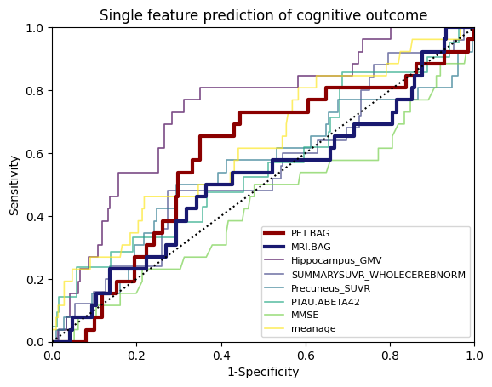
Sensitivity
FDG-PET BAG
MRI BAG
Hippocampus GMV
AV45-PET
Precuneus SUVR
p-tau₁₈₁/Aβ₁₋₄₂ ratio
MMSE
age
1-Specificity

Slide 9
MCI

Slide 10
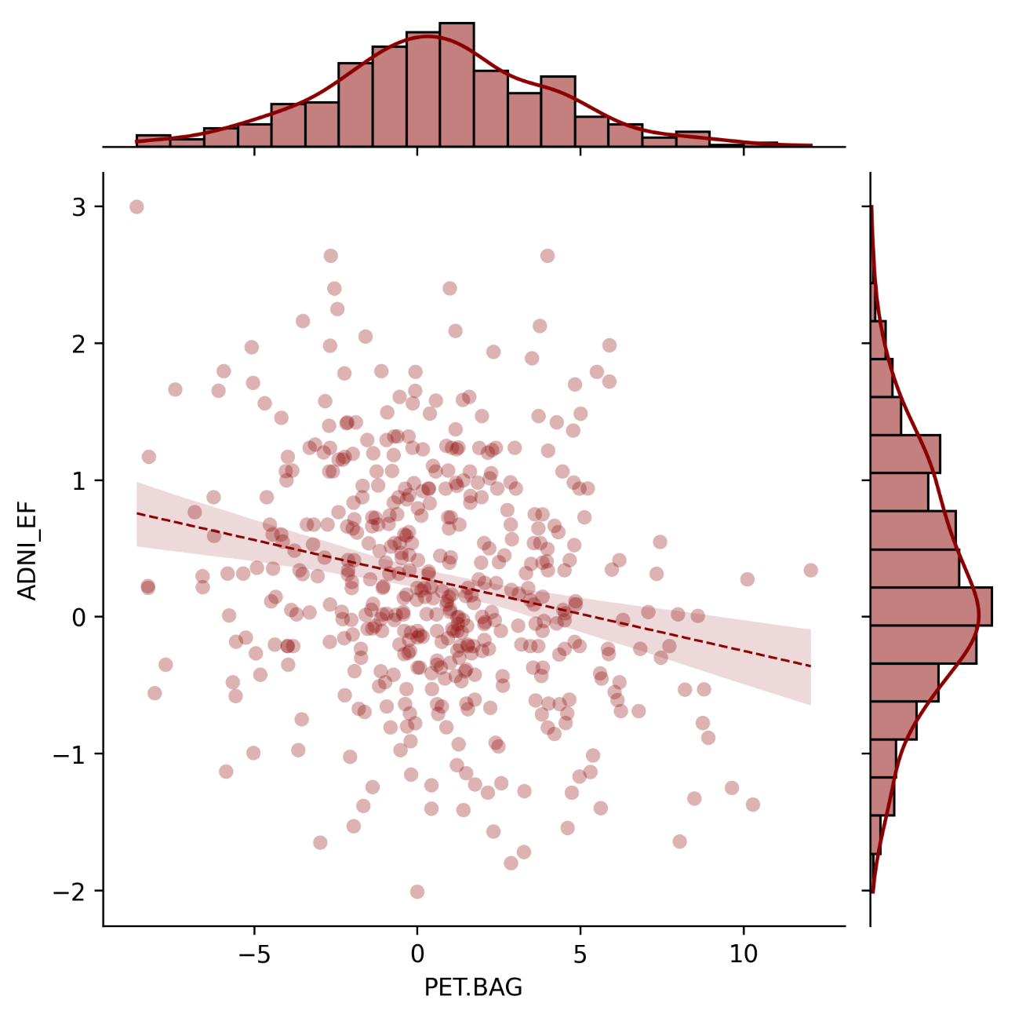
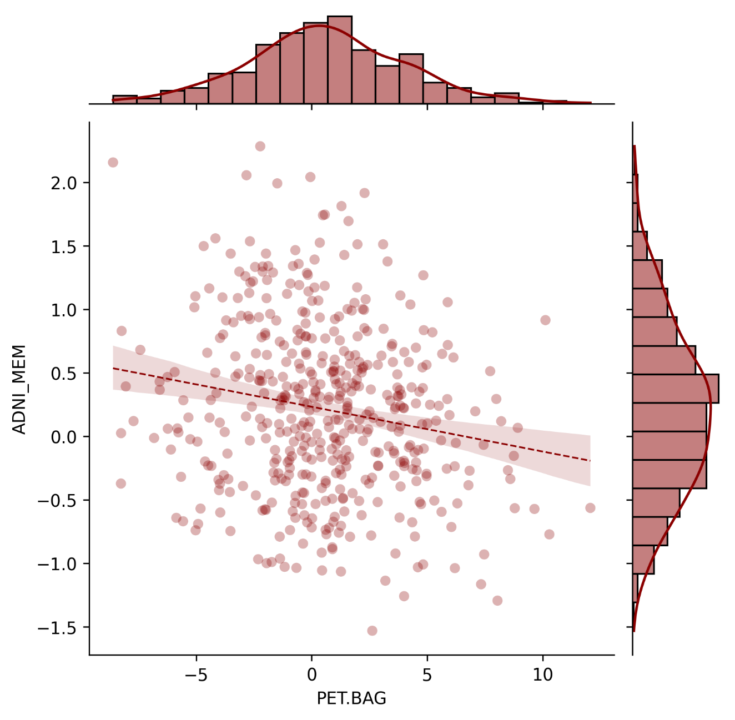
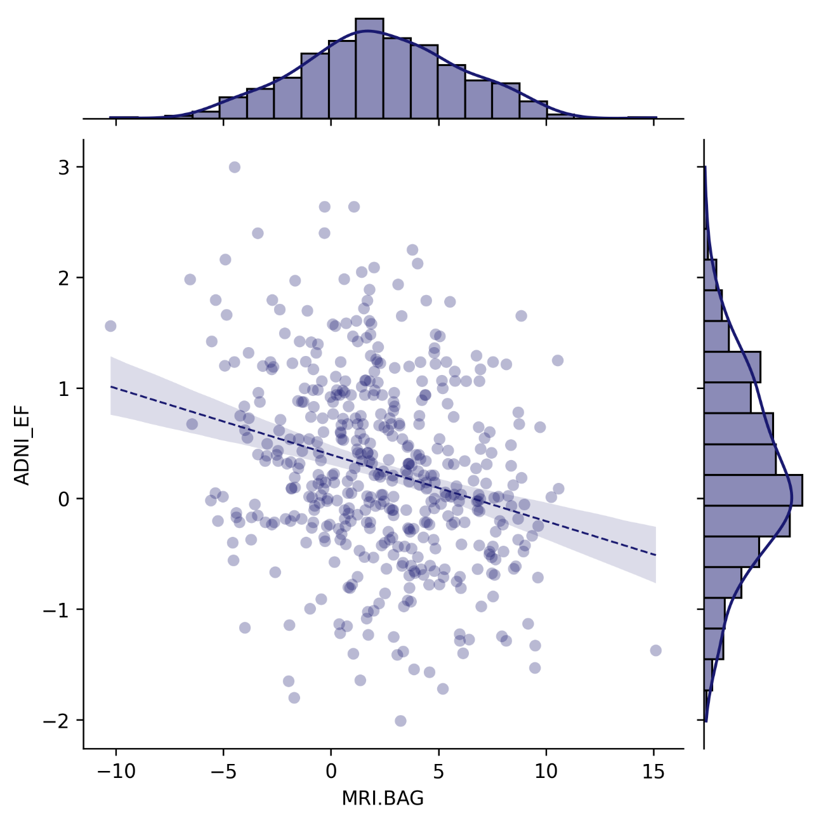
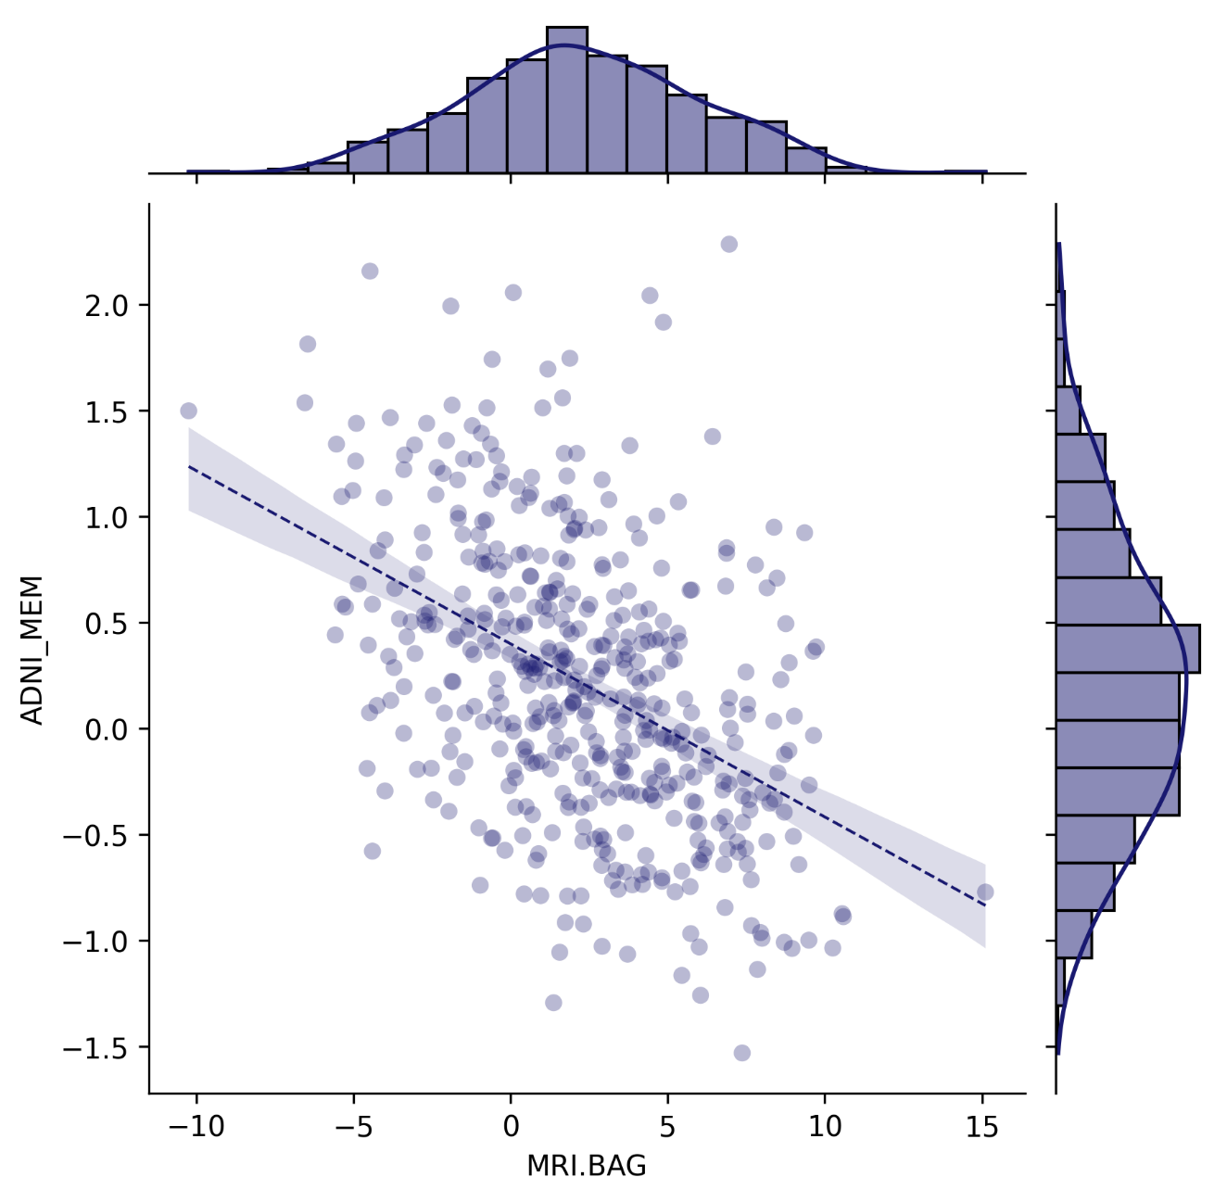
Cognitive Performance
ADNI-EF
ADNI-MEM
ADNI-MEM
ADNI_EF
FDG-PET BAG
n r CI95% p-val
pearson 460 -0.242787 [-0.33, -0.15] 1.529072e-07
MRI BAG:
n r CI95% p-val
pearson 460 -0.217039 [-0.3, -0.13] 0.000003
ADNI_MEM
FDG-PET BAG
n r CI95% p-val
spearman 460 -0.159721 [-0.25, -0.07] 0.000619
MRI BAG:
n r CI95% p-val
spearman 460 -0.397462 [-0.47, -0.32] 1.041420e-18
FDG-PET BAG [years]
FDG-PET BAG [years]
ADNI-EF
ADNI-MEM
MRI BAG [years]
MRI BAG [years]

Slide 11
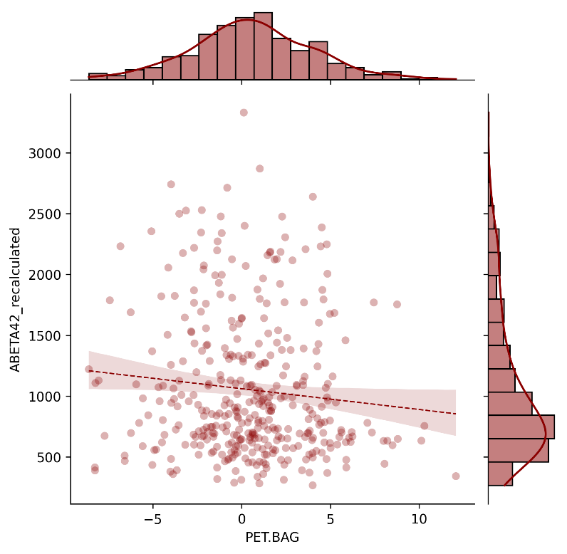
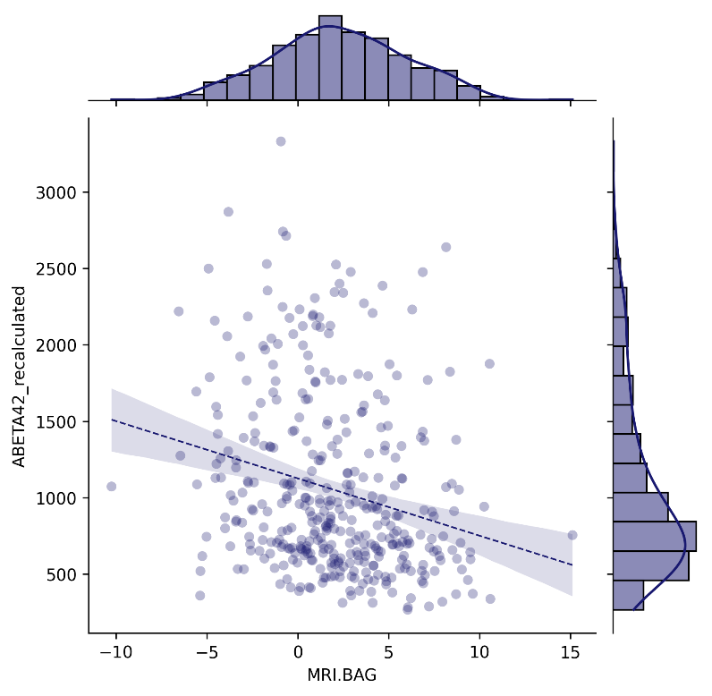
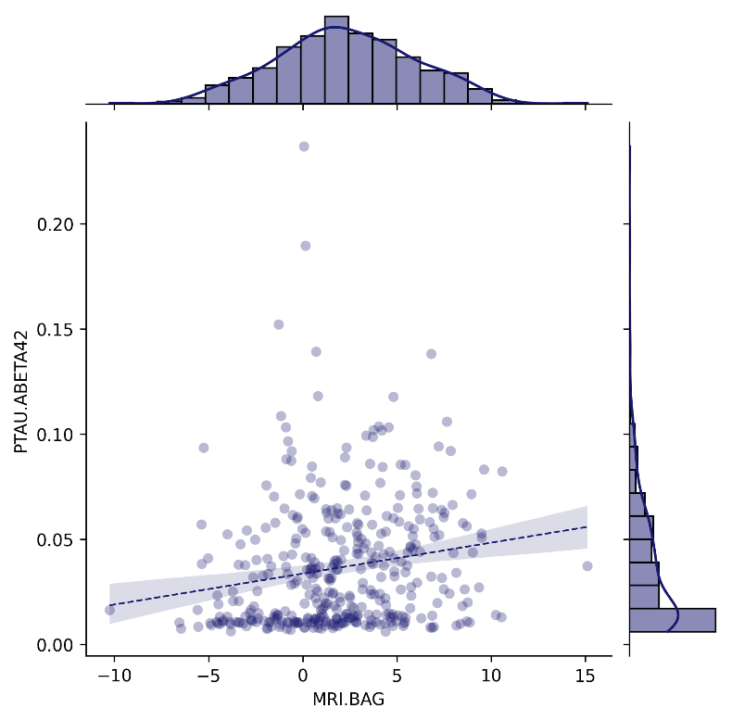
Pathology
SUMMARYSUVR_WHOLECEREBNORM
FDG-PET BAG
n r CI95% p-val
spearman 326 0.03759 [-0.07, 0.15] 0.50149
MRI BAG:
n r CI95% p-val
spearman 326 0.065017 [-0.04, 0.17] 0.244671
ABETA42_recalculated
FDG-PET BAG
n r CI95% p-val
spearman 376 -0.124063 [-0.22, -0.02] 0.016664
MRI BAG:
n r CI95% p-val
spearman 376 -0.18904 [-0.29, -0.09] 0.000245
TAU
FDG-PET BAG
n r CI95% p-val
spearman 376 -0.014175 [-0.12, 0.09] 0.785246
MRI BAG:
n r CI95% p-val
spearman 376 0.053608 [-0.05, 0.15] 0.302435
PTAU
FDG-PET BAG
n r CI95% p-val
spearman 376 -0.01477 [-0.12, 0.09] 0.776468
MRI BAG:
n r CI95% p-val
spearman 376 0.058596 [-0.04, 0.16] 0.259609
PTAU.ABETA42
FDG-PET BAG
n r CI95% p-val
spearman 376 0.082403 [-0.02, 0.18] 0.112583
MRI BAG:
n r CI95% p-val
spearman 376 0.174924 [0.07, 0.27] 0.000702
CSF Aβ₁₋₄₂ [pg/ml]
FDG-PET BAG [years]
CSF Aβ₁₋₄₂ [pg/ml]
p-Tau₁₈₁/CSF Aβ₁₋₄₂ ratio
MRI BAG [years]
MRI BAG [years]

Slide 12
FDG-PET BAG:
Source SS DF F p-unc np2
DX.cat.n 103.724992 1 9.006219 0.002839 0.019410
PTEDUCAT 2.167407 1 0.188191 0.664632 0.000413
APOE4 11.887270 1 1.032146 0.310195 0.002263
PTGENDER 24.922892 1 2.164001 0.141968 0.004734
Residual 5240.253368 455 NaN NaN NaN
MRI BAG:
Source SS DF F p-unc np2
DX.cat.n 699.012641 1 63.164473 1.511136e-14 0.121900
PTEDUCAT 1.750893 1 0.158215 6.909919e-01 0.000348
APOE4 0.806088 1 0.072840 7.873681e-01 0.000160
PTGENDER 350.278959 1 31.652054 3.226610e-08 0.065040
Residual 5035.279144 455 NaN NaN NaN
Mean PET BAG stables: [0.31872936], mean PET BAG decliners: [1.36297451].
Mean MRI BAG stables: [1.5395402], mean MRI BAG decliners: [4.55615362].

Slide 13
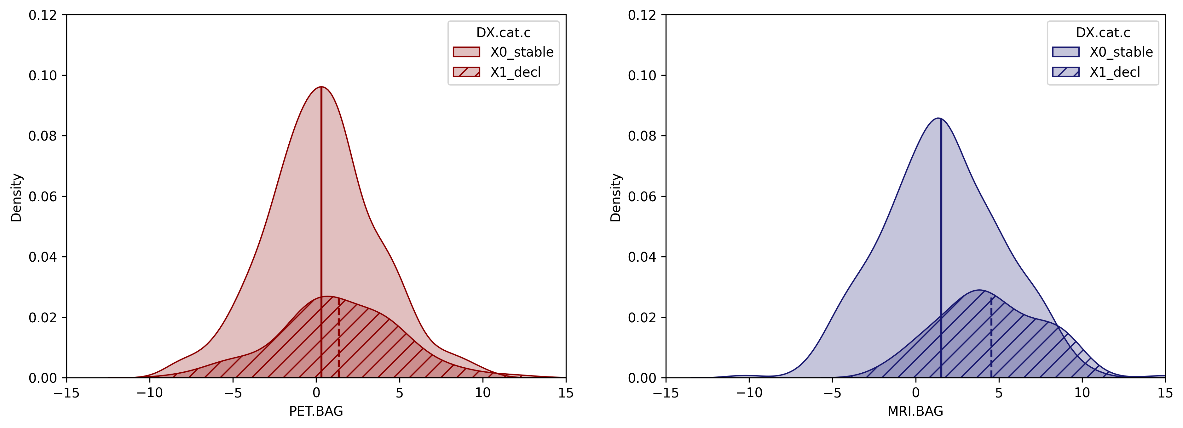
p = .002
Category
p < .001
Category
Stable
Decline
Stable
Decline
Density
Density
FDG-PET BAG [years]
MRI BAG [years]
Notes:
R ANCOVA results pending

Slide 14
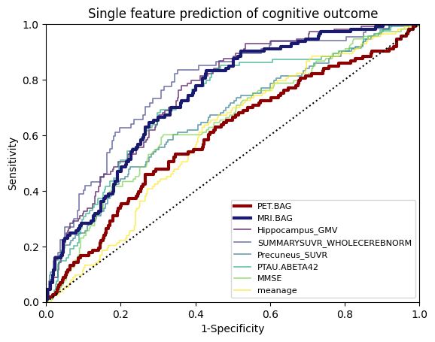
PET.BAG
460 subjects with full information.
AUC: 0.5956827797281484
MRI.BAG
460 subjects with full information.
AUC: 0.7380264159281172
Hippocampus_GMV
460 subjects with full information.
AUC: 0.7603276622558285
SUMMARYSUVR_WHOLECEREBNORM
326 subjects with full information.
AUC: 0.7746622909518837
Precuneus_SUVR
460 subjects with full information.
AUC: 0.6722600839614071
PTAU.ABETA42
376 subjects with full information.
AUC: 0.7222148939600463
MMSE
460 subjects with full information.
AUC: 0.6447680832085368
meanage
460 subjects with full information.
AUC: 0.6046698418153995
Sensitivity
FDG-PET BAG
MRI BAG
Hippocampus GMV
AV45-PET
Precuneus SUVR
p-tau₁₈₁/Aβ₁₋₄₂ ratio
MMSE
age
1-Specificity

